Slide 1
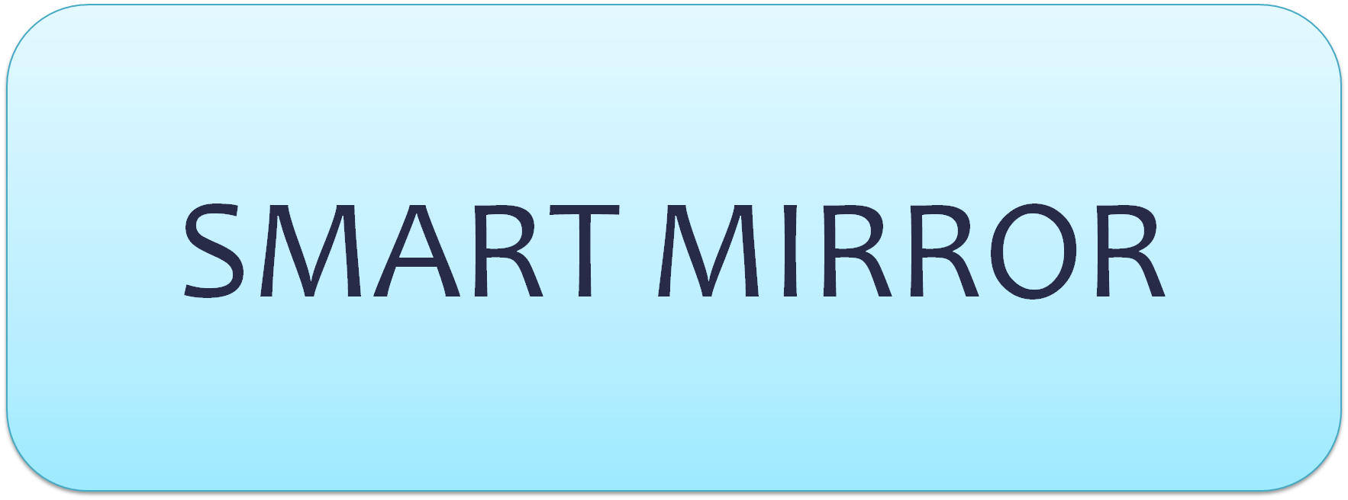
SMART MIRROR
SAVE THE TIME

Slide 2
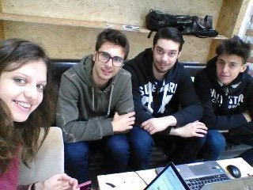
Team Members
Boris di Chio
Alexandra Maria Farcas
Andrea Russotto
Jari Giuseppe Stimoli

Slide 3
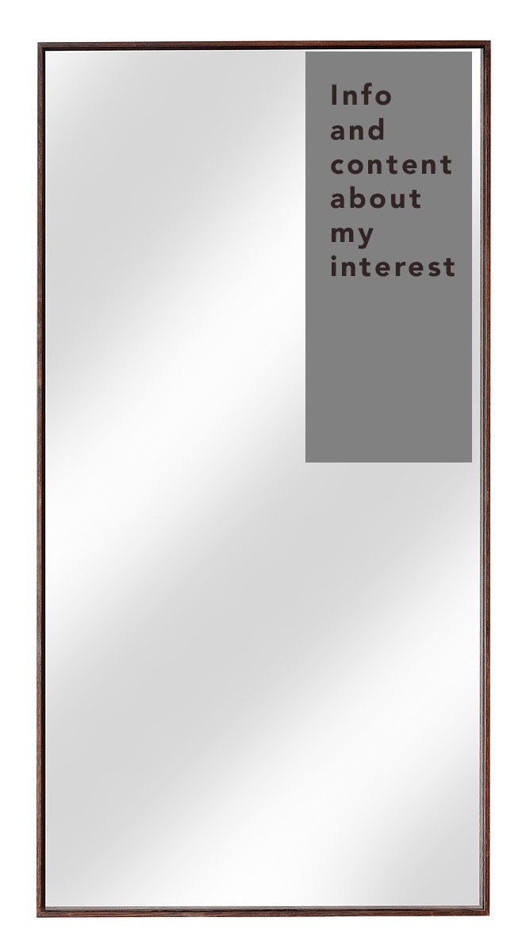
Project idea
At the beginning, the first idea was to build a “Smart mirror” that showes in a portion of the mirror , all the information and content chosen by the user with his smartphone.

Slide 4



Used Object
LCD monitor
Laptop
Webcam

Slide 5
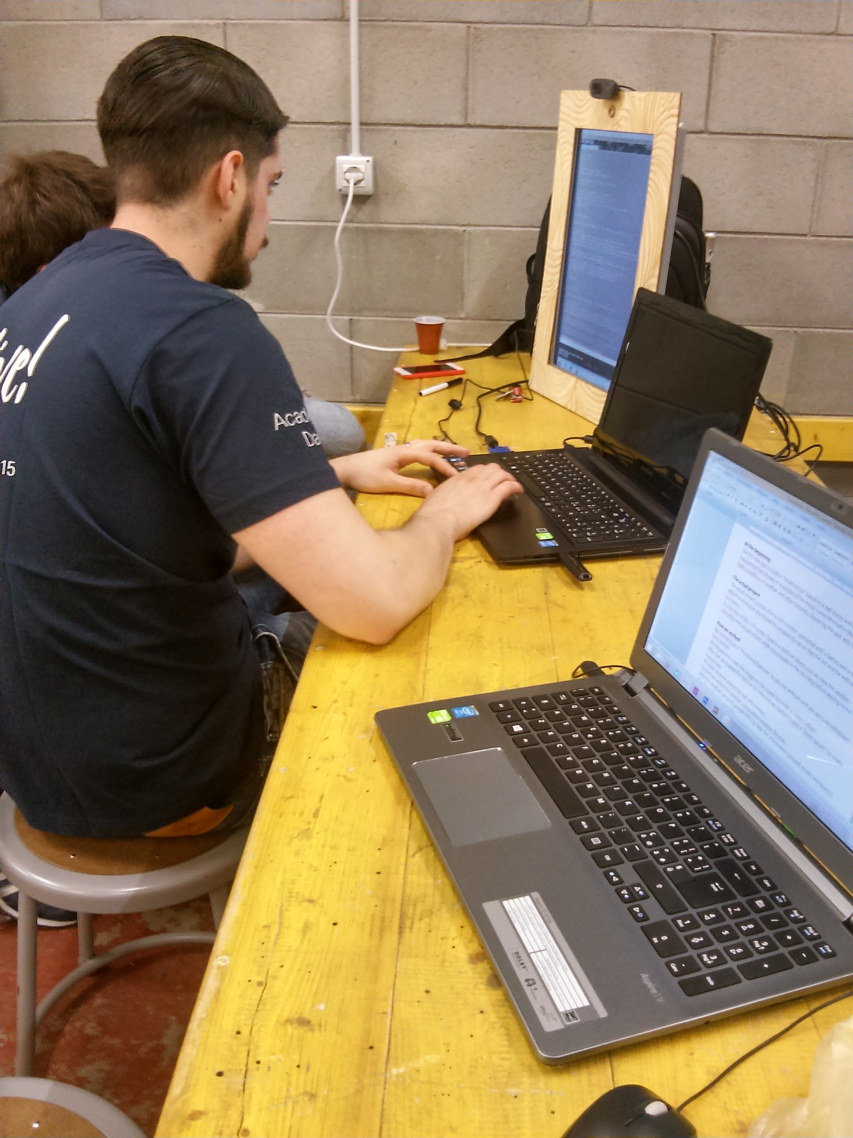
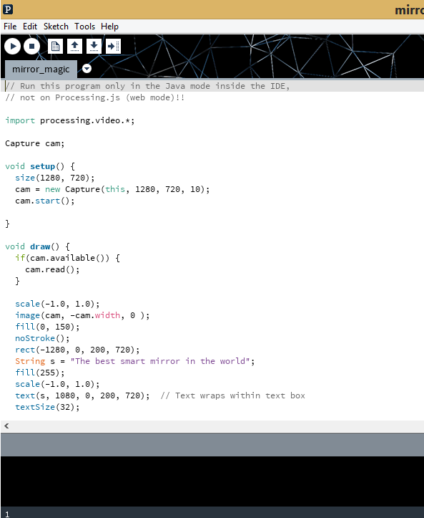
Work in progress

Slide 6


Function laptop
The project consist of in a LCD monitor, connected with a laptop and a webcam.
With Processing we must develop the program to run so that the lcd and the webcam will be our mirror.

Slide 7



What do you want to see?
In a portion of this LCD screen there will be a matt bar where you can view the weather, email and events while you prepare in the morning before leaving home.

Slide 8
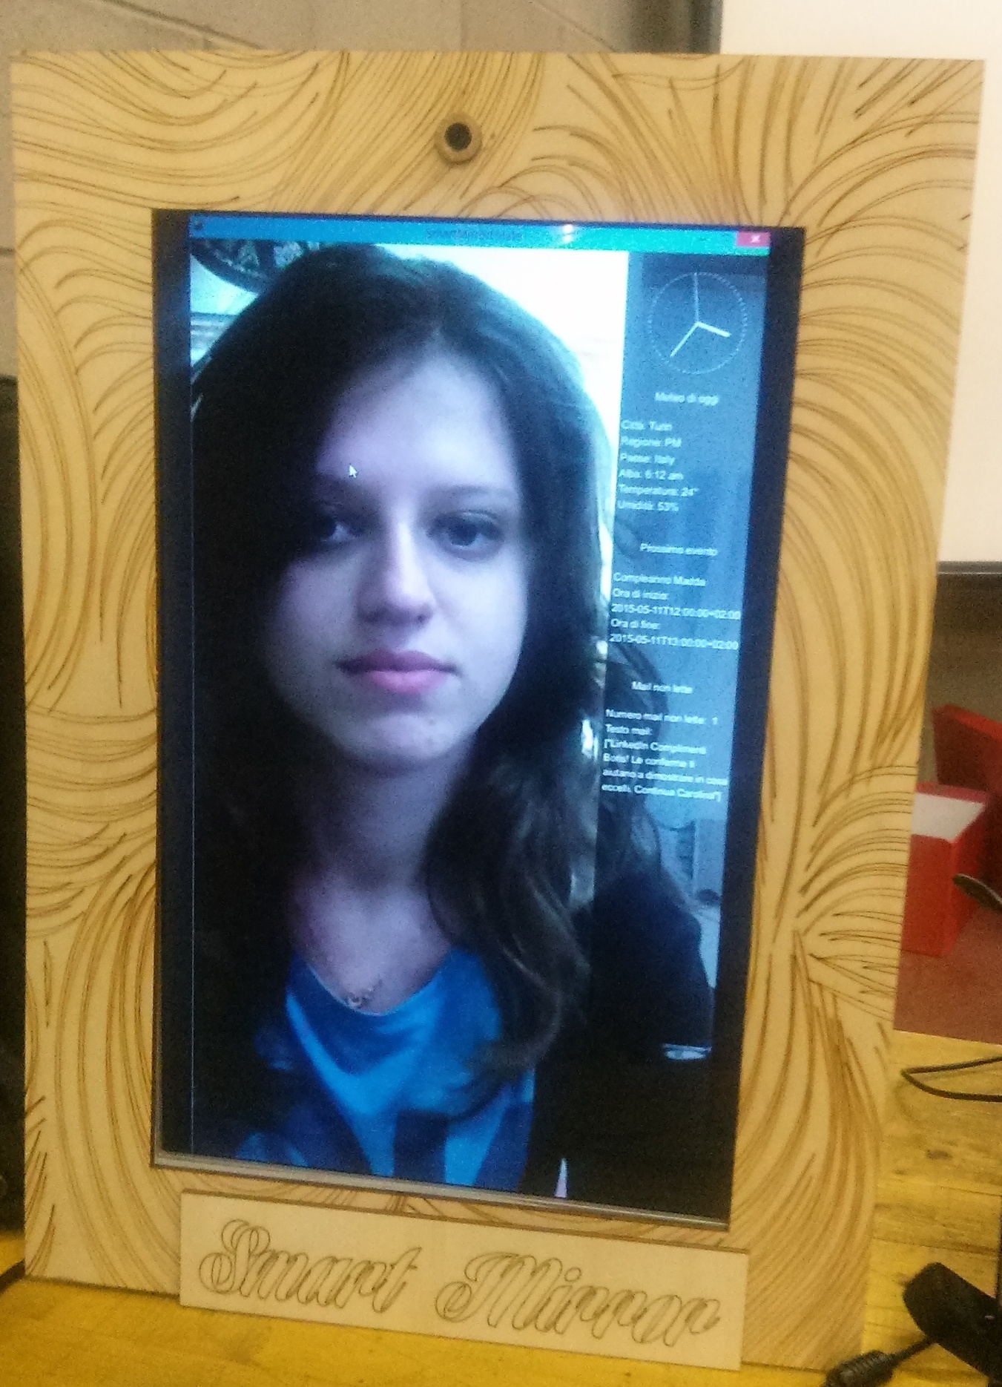
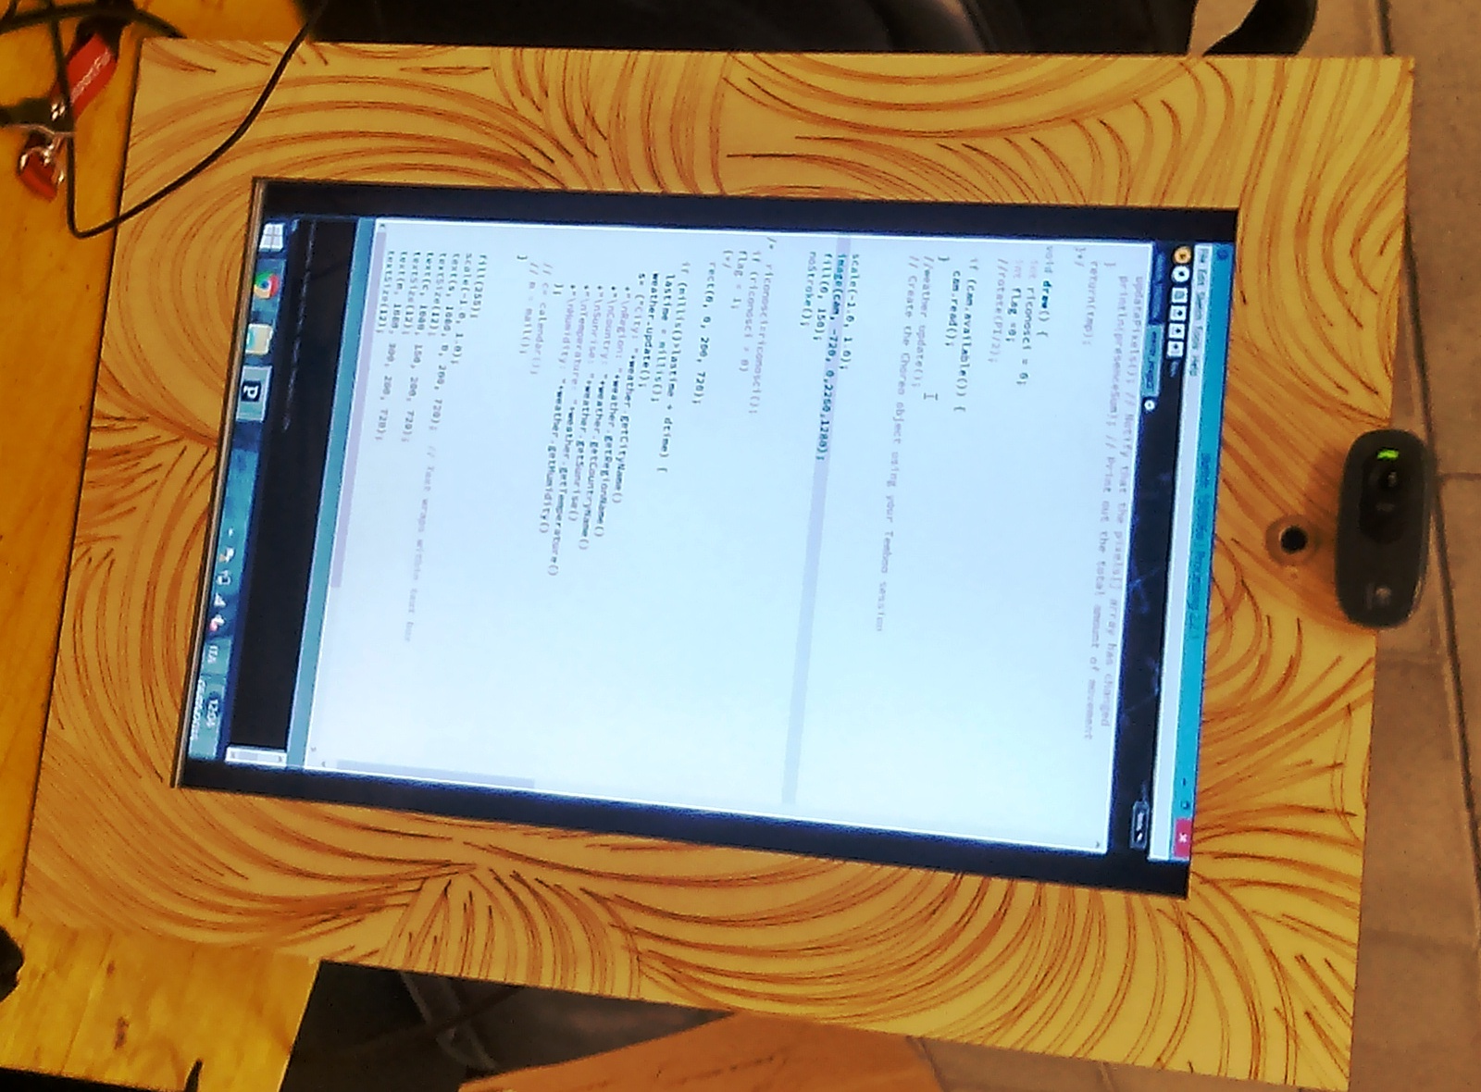
Mirror Display

